Slide 1

Business Communication & Proactiveness
Md. Alamin Hossain

Slide 2
Contents
What is Communication & Mediums
?
Verbal and non verbal communication?
Proactiveness
steps of being proactive
1
3
5
7
Communication at
Workplace
workplace communication steps
Proactive vs. Reactive
2
4
6

Slide 3
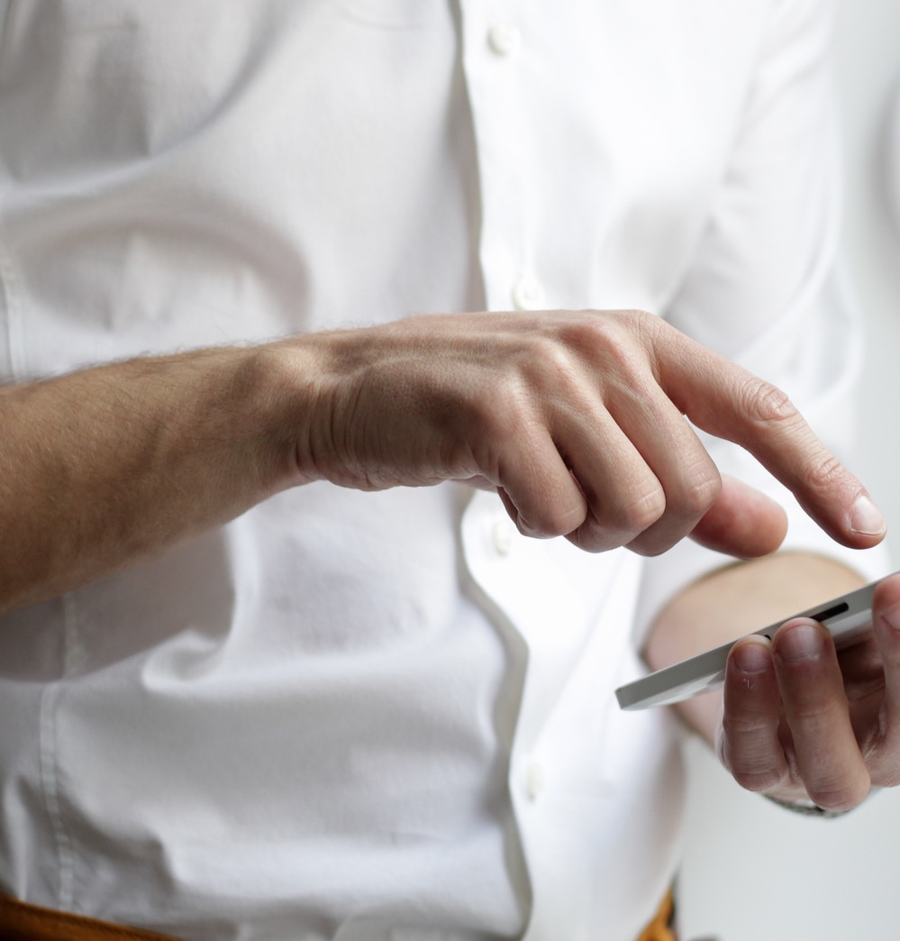
Communication &Mediums
In-person
These conversations can be used build relationships, trust, or deal with time sensitive issues.
Text/Chat
Chatting is best for short and simple messages.
Communication is the act of transferring information from one place to another.

Slide 4
Communication &Mediums
Meetings
Meetings are held when many people need to decide, gain alignment on a topic or create something collaboratively.
Email
Emails are good as you can copy people, forward information, send attachments and have a time and date stamped paper trail.
Communication is the act of transferring information from one place to another.

Slide 5
Communication &Mediums
Phone /Video chat
This is a great alternative when in-person conversations are not possible. Use for quick alignment, clarification or a quick discussion.
Communication is the act of transferring information from one place to another.

Slide 6
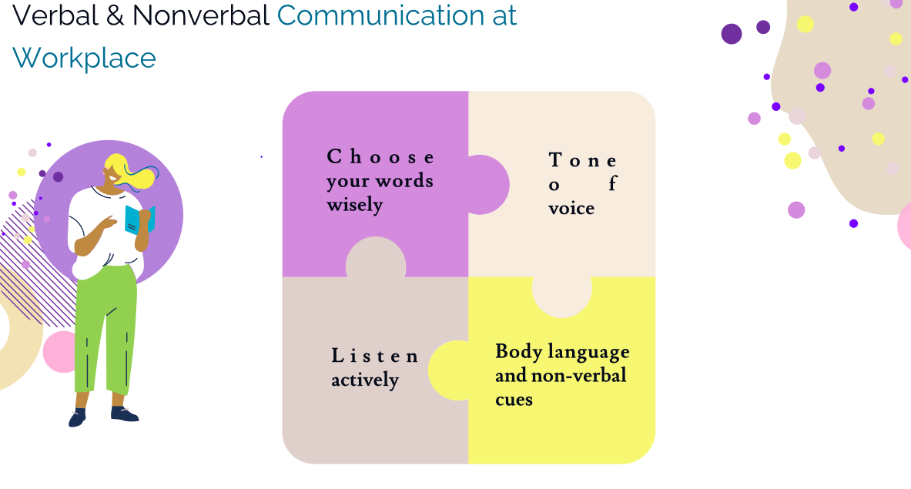

Slide 7


IN WorkPlace
Things we should keep in mind
Choosing word
Tone of Voice
Voice pinch
Breathing
Volume of voice
Pace of speech

Slide 8
IN WorkPlace
Things we should keep in mind
Listen Actively
Body language and gesture

Slide 9

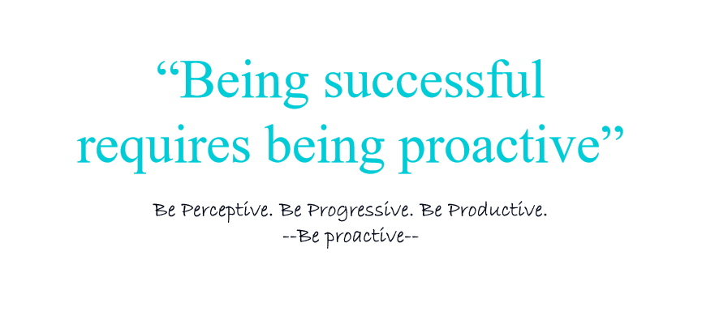
Proactiveness
The proactive people control situations by causing things to happen rather than waiting to respond after things happen.

Slide 10
Proactive vs. Reactive
Proactive Approach:
Reactive Approach:
Takes initiative and anticipates future events or needs
Forward-thinking mindset
Involves planning and preparation
Anticipates future needs, changes, or challenges
Benefits:
Improved efficiency
Better problem-solving
Increased success rate
Responds or takes action after an event or situation has occurred
Responsive rather than proactive mindset
Focuses on reacting to unfolding events
Primarily useful for handling emergencies
Limitations:
Reduced efficiency
Limited problem-solving
Higher risk

Slide 11
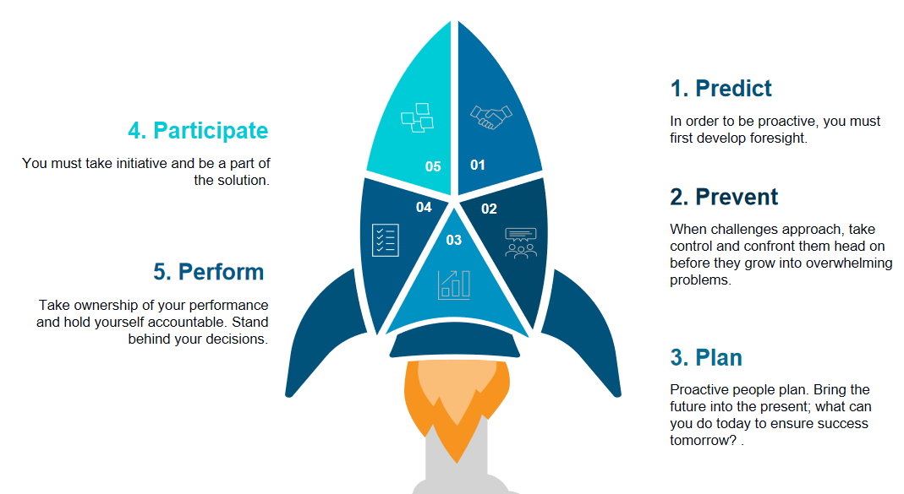
Large image
5 P’s of being proactive

Slide 12


Thank You
Md. Alamin Hossain

